Slide 1

Integrated and Continuous Biologics Pharmaceutical and Vaccine Manufacturing Virtual Meeting
September 22nd, 2020
Advanced Manufacturing of Recombinant Proteins
Steven Kozlowski, Director OBP
Office of Pharmaceutical Quality, CDER

Slide 2
Framing Questions
What is the current technical status? What could a horizon goal process look like?
What are the opportunities, including business case, and barriers?
What strategies would help to reduce those barriers?

Slide 3
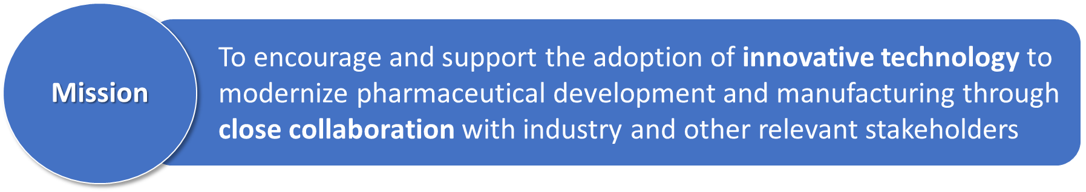
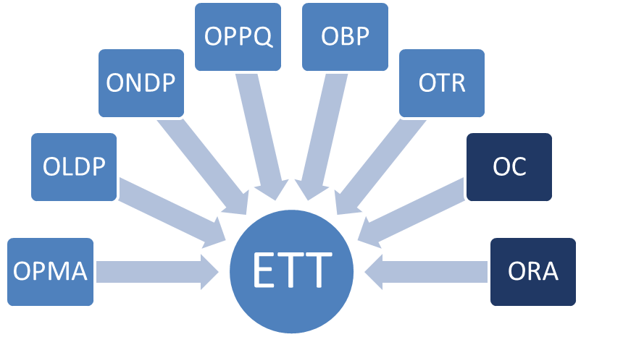
Current: Emerging Technology Program
A cross-functional Emerging Technology Team (ETT) with representation from all relevant FDA quality review and inspection programs (OPQ/CDER, OC/CDER, and ORA)
Adapted from Larry Lee

Slide 4
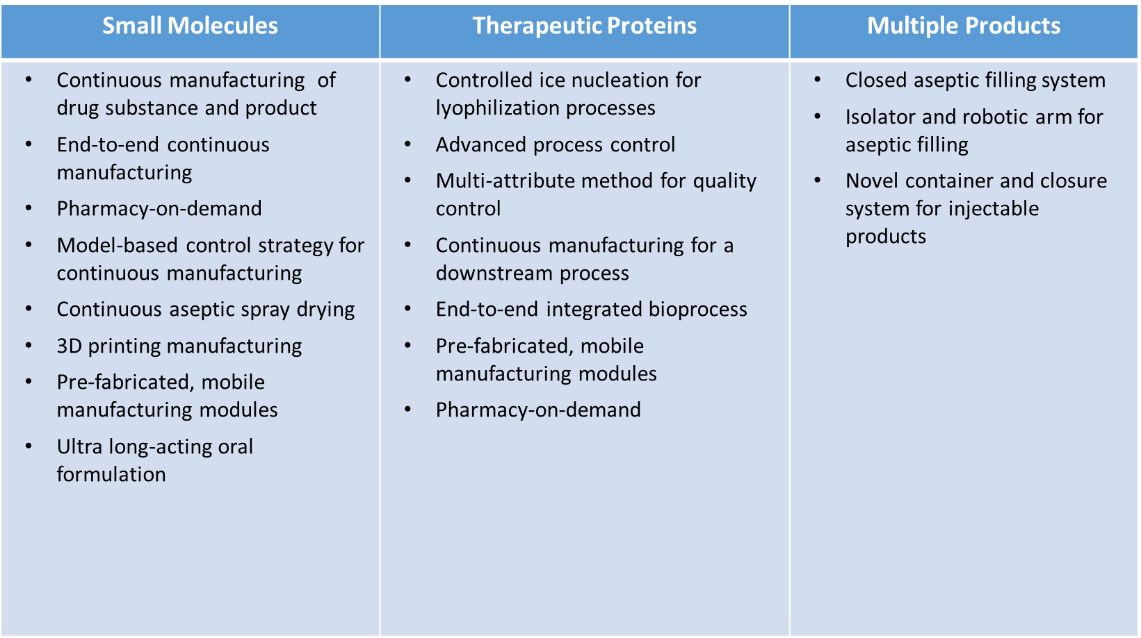
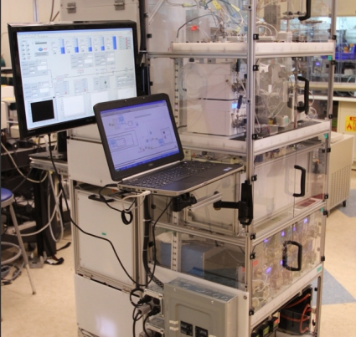
Current: ETT Technology Pipeline
Accepted over 60 proposals
Approval of 3D printing technology
Approval of 5 NDAs and 2 supplements using continuous manufacturing
Adapted from Larry Lee
Notes:
Vertex (Orkambi, approved 2015): NDA, cystic fibrosis indication, orphan drug
Janssen (Prezista, approved 2016): sNDA, antiviral for HIV
Lilly (Verzenio, approved 2017): NDA, breast cancer
Vertex (Symdeko, approved 2018):NDA, cystic fibrosis (orphan)
Pfizer (Daurismo, approved 2018): NDA, leukemia (orphan)
Vertex (Trikafta, approved 2019): NDA, cystic fibrosis (orphan)
GSK (Flovent HFA, approved 2019): sNDA, asthma
3D printing technologies
Aprecia (Spritam, approved 2015): NDA, seizures/epilepsy

Slide 5
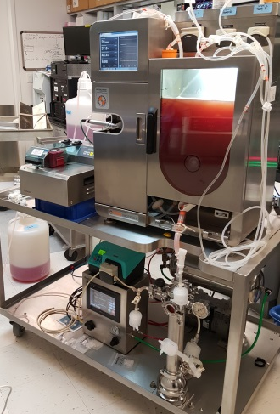
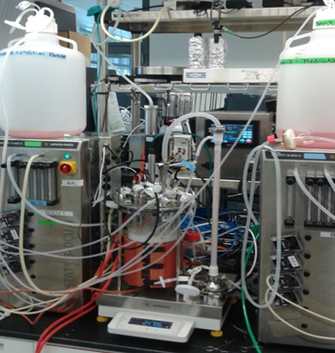

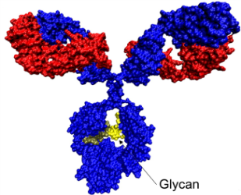


Current: Advanced Manufacturing Research
CDER/OPQ
Manufacturing Pilot Plant
Increase FDA’s capability to generate knowledge and train FDA staff to support assessment, inspection, and policy and guidance development for advanced manufacturing
Continuous Perfusion
Bioreactors
Primary Clarification of CHO Harvested Cell Culture Fluid using an Acoustic Separator.
J. Vis. Exp. (159), e61161, doi:10.3791/61161 (2020).

Slide 6
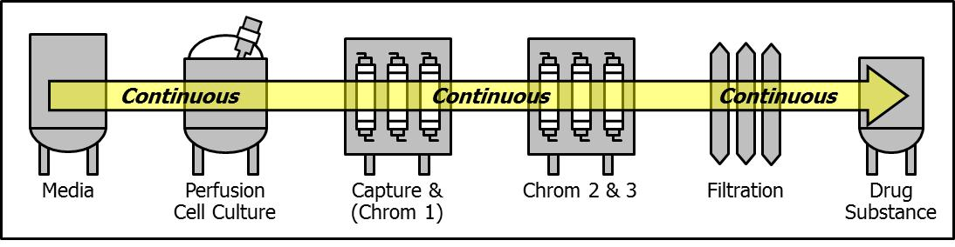
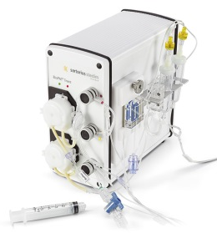
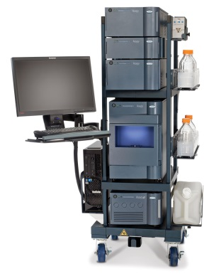
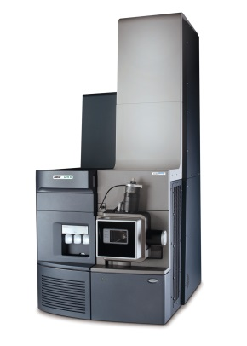
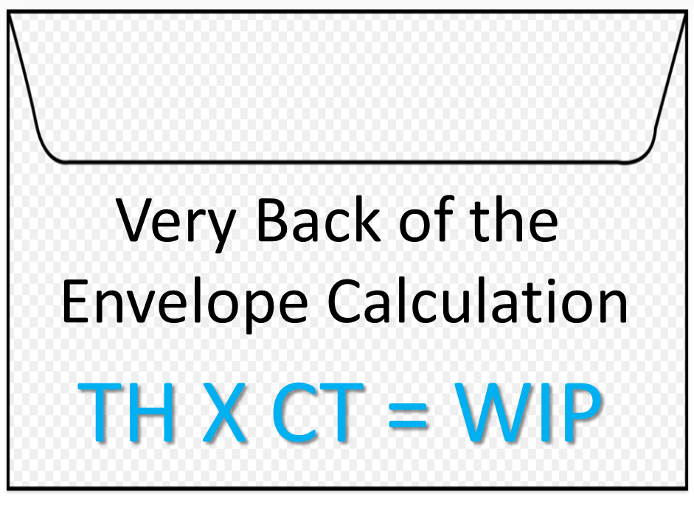
Horizon: DS
Mock Batch Process
Seed Train
10K Liter Batch Bioreactor
Harvest Centrifuge
3-Column Purification
Diafiltration & Fill
O₂/CO₂
Metabolites
Biomass
HPLC
UPLC
Analysis
ToF-MS
Analysis
Throughput (TH) = 7000 100mg dose equivalents per day
Cycle time (CT) = 50 days
Work in Process (WIP) = 350,000 dose equivalents
7000 X 2 = 14,000
May avoid queue time increases due to variability & high utilization
Need a highly integrated process (PAT)
6 Holds/Transfers
Can serve as WIP buffers

Slide 7

Barriers & Opportunities: Regulatory
OPQ Definition of Pharmaceutical Quality
Assuring every dose is safe and effective, free of contamination and defects.
A control strategy is a planned set of controls, derived from current product and process understanding, that assures process performance and product quality.
Continuous Manufacturing Control Strategy
Definition of Batch
Real time release testing
Evaluation of viral clearance performance
Diversions of non-conforming material
Adapted from Joel Welch
Notes:
RTRT Continuous biotechnology processes still largely rely on end-product testing
CM impacts resin reuse, protein concentration; Viral Clearance Model Study Design; Line Reuse
Out-Of-Specification lots should not be blended with other batches for the purpose of meeting specifications
Description should be provided for how diversion is performed

Slide 8
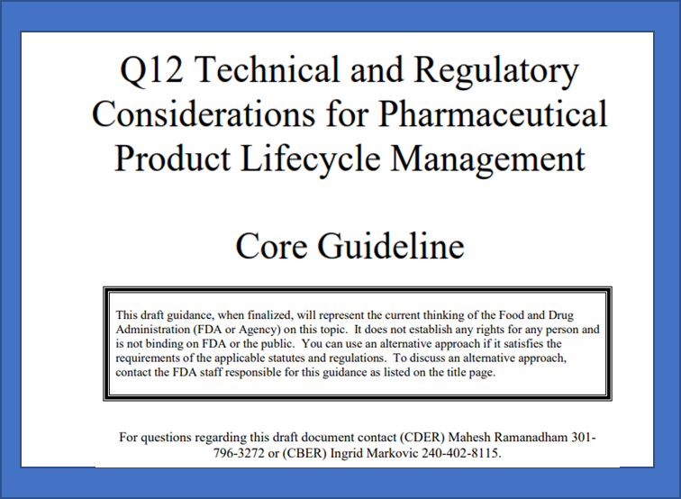
Opportunities: Regulatory Flexibility
ICH Q12 Established Conditions
Parameter-based
A minimal approach
An enhanced approach
A performance-based approach
ICH Q5A Viral Safety
Validation strategies for CM and platforms
Alternative assay formats (NGS)
ICH Q14: Analytical Procedure Development
multivariate models
ICH Q13: Continuous Manufacturing
CM-related definitions
Key scientific approaches for CM
Regulatory concepts and expectations

Slide 9
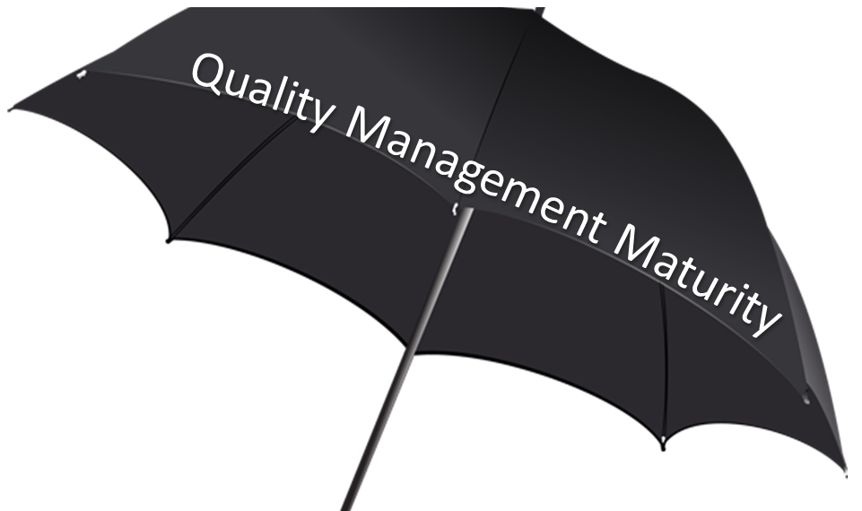
Barriers & Opportunities: Metrics
Basic quality management systems are generally reactive and focused on CGMP
More mature quality management systems are ones that proactively focus on performance and patient-centric events
Technology, Equipment
Process Characteristics
Inspectional Outcomes
BPDRs, Recalls
Shortages
Quality Metrics
Process Modeling
Predictive Analytics

Slide 10
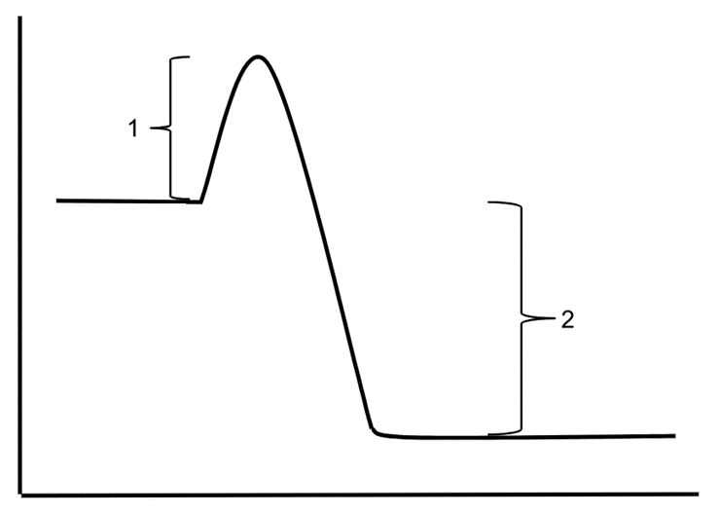
Strategies: Activation Energy
Typical
New Drugs
Sweet Spot
Cost
Biosimilars
Capacity for Capital Investment
Time
Typical
Generics
Current Drivers
Capacity for Investment
Brand Impact
Leading Edge
Risk of Shortage
COG not yet a key driver
What fits in the sweet spot?
Importance of COG (Commodity)
What is the “Tipping Point”?
CC License Provenzano15

Slide 11
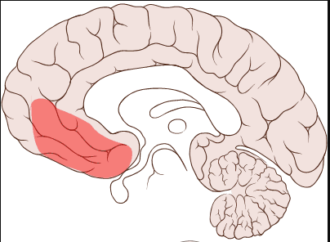

Strategies: Sunk Cost Fallacy
A sunk cost is a cost that has been incurred and cannot be recovered.
Existing capacity is not a sunk cost as long as it can still manufacture competitively; It has future value
Low marginal cost of existing manufacturing technologies. 2018 Bates White → Continuous manufacturing in pharmaceuticals: Economic and policy issues
Physical capital of publicly traded pharma companies > $200 billion
Existing manufacturing capacity is long-lived; Utilization not high
New capacity
HBR Stop Doubling Down on Your Failing Strategy
by Freek Vermeulen and Niro Sivanathan; HBR Nov–Dec 2017
Escalation of commitment is deeply rooted in the human brain;
More to this than the Sunk Cost Fallacy: Loss Aversion, Personal Identification, Illusion of Control
Regulatory Affairs
GNU Free Documentation License. Finereach
Notes:
Is COVID an opportunity
Need for new capacity balanced by no room for delay

Slide 12

Strategy: Business Model Innovation
Four Paths to Business Model Innovation by Karan Girotra and Serguei Netessine
July–August 2014 issue of Harvard Business Review.
What your [focus] will be
Focus on areas near the sweet spot
Contract manufacturing may be a tipping point
When decisions are made
Decisions on new capacity should always consider Advanced Manufacturing
Who makes them, and
Decisions should be made by those who are not biased by “escalation of commitment”
Why they are made.
Company incentives should consider long term cost and quality
Quality Maturity Models should be sensitive to CM advantages
Incentives should focus on moving towards a tipping point where market forces drive Advanced Manufacturing
By Alinaderi158 [CC BY-SA 4.0 (https://creativecommons.org/licenses/by-sa/4.0)], from Wikimedia Commons

Slide 13
Thank You!
What is the current technical status? What could a horizon goal process look like?
What are the opportunities, including business case, and barriers?
What strategies would help to reduce those barriers?

